Slide 2
Build your Service Using AWS Tech!
Uttara Shekar
Melonia Mendonca
Community News Bulletin
Notes:
Introductions:
Hi everyone and welcome to the “Build you Service Using AWS Tech!” workshop. I’m Melonia Mendonca. I’m a software developer at AWS for over 4 years now. Before this, I was at Intel corporation for 3 years. I have a masters from Georgia Tech in Electrical and Computer Engineering. Fun fact: This is my first year attending GHC and I’m super exceited to have the opportunity to be doing this workshop in the same. With me is Uttara Shekar . Uttara, I’ll let you introduce yourself. …….. We will be your hosts throughout this workshop.

Slide 3
Agenda
Brief overview of AWS technologies
Details on what we are building
Workshop Setup
Get Hands on with AWS
Questions and Answers
Notes:
This is the agenda that we will be going over in this workshop. In this workshop, we are primarily building a service, that is backed by AWS technologies.
Because of the difficult times we are facing with the COVID -19 pandemic, we decided to create a community news bulletin that can help us stay informed about our community with regards to health, local businesses etc. This news bulletin will be powered in the back by some of the most popular AWS technologies. We will learn what they are, how we can create them, and integrating them into one service. As part of the workshop, you get to create this bulletin yourself too!
As part of registering for this workshop, you would have all got a personal handbook. Please keep the handbook ”handy”, because we plan on picking out a few links from there. Nonetheless, the handbook is written such that it goes over everything that we plan on doing as part of this workshop, so it should be easy to help you jog your memory if you plan on revisiting this topic in the future!
A quick note: If you have any issues during the workshop with the setup or any other technical questions, please feel free to ask in chat, and I’ll get back to you as soon as I can.

Slide 4
Prerequisite
Create an AWS account
Go to https://aws.amazon.com
Navigate to “Sign in to Console” on the far top right
Click on “Create a new AWS account”
Install Python on your terminal
Go to https://www.python.org/downloads/
Download the latest version of Python
Install NPM
Go to https://www.npmjs.com/get-npm
Click on the Download Node.js and npm button
Install Git
Go to https://git-scm.com/downloads
Notes:
This is a prerequisite to be able to make progress in this workshop. Uttara has added detailed instructions in the chat box for your reference. In case you don’t already have an AWS account, python3 installed or NPM on your machines, please use the time in which I go over the technologies to do these things.
With respect to the AWS account creation, you will be asked for your banking information. None of the resources that we create in this workshop should charge you anything, and we will be going over how to delete your resources such that you aren’t charged later as well.

Slide 5
Terminology
Notes:
So while you are getting set for the workshop, lets get acquainted with a few words that we will be using a lot as part of this workshop.

Slide 6
Web service
Scalability
Availability
API
Notes:
Web service - A web service is a piece of software that enables machines to interact over a network. Cloud provided solutions enable users to quickly create web services of their own without worrying about managing costly infrastructure
Scalability or the ability to scale – It is the capacity of a service to take in more and more requests. Thinking technically, these web services that we create are all running on physical computers somewhere and these computers can just take so many requests parallelly. When something “scales”, it improves its ability to take on more work.
Availability – Availability can be defined as the time for which your service is running. In basic Math, it’s the up time over the total time.
API – Application Programming interface is a definition or a protocol that allows you to interact with other services, and allows other services or users to interact with you!

Slide 7
AWS Technologies
Notes:
So what are these popular AWS technologies that I’m talking about? I will just be going over some of the technologies briefly, before we get our hands dirty and start building our own service.
When we talk AWS, the most popular service that comes to mind is ..

Slide 8
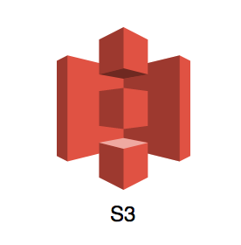
Amazon S3
Store large amounts of data
Easy retrievals
Scalable, high availability, secure
Notes:
In simple words, Amazon S3 is a web service that allows you to store and retrieve large amounts of data. Due to its industry leading performances, high availability and security, Amazon S3 allows your services to scale based on the requirement.

Slide 9
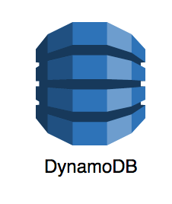
Amazon DynamoDB
NoSQL database
Key-value store
High availability, Scalable, Secure
Fast and consistent
Notes:
Amazon DynamoDB is a fully managed noSQL database. NoSQL technology is a modern type of data modeling technology for databases. Another type of database technology that a lot of you might be more familiar with is SQL, which is known for providing scalable results for ad-hoc or complex queries that you’re not familiar with. NoSQL, on the other hand, is perfect for use cases where we know what queries we need to make on the database. It’s mostly like a key-value store. As all AWS technologies, it is scalable and secure and also fast and convenient to use.

Slide 10
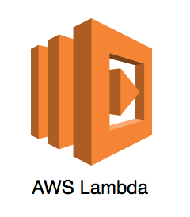
AWS Lambda
Serverless architecture
Manages scaling
Load balancing
Event driven architecture
Highly available, scalable, secure
Notes:
AWS Lambda is AWS’s solution to serverless compute. Serverless compute does not mean there are no servers on which your program / code runs. It means that you don’t need to manage the hosts and infrastructure. This means you don’t need to spend time scaling your infrastructure up when the call volume increases, nor do you need to worry about scaling down and saving some money, when the call volume is lower and the high number of infrastructure hosts are not required; Another meaning of managing your infrastructure would be load balancing the requests. All of this is taken care of for you by AWS Lambda, giving you an illusion that you don’t have a server on which your service is running.
Event driven implies that it is triggered by the occurrence of an event.

Slide 11
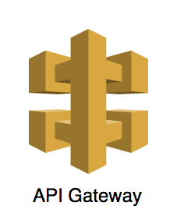
Amazon API Gateway
API management tool
Front door for requests
High availability, scalable and secure
Notes:
An API gateway is an API management tool that resides between the client making the requests and the backend services. It basically accepts requests and translates and transfers them such that the service can react to it and then sends a response back to the customer. AWS also provides with Amazon API Gateway for the same purpose of acting like the front door for applications to access data, business logic and/functionality from backend services.

Slide 12
AWS Amplify
Powerful tools to build secure and scalable applications
Builds the bare-bones of back-end
Provides a framework for front-end
Notes:
AWS Amplify isn’t a “web service”. It is an AWS technology that makes it super simple to quickly build full stack applications powered by AWS. It helps to build back-end resources like DynamoDB tables, S3 buckets, etc. as also provide a framework on which you can build your front-end or the page that you see on your browser. We will be taking advantage of this technology in our workshop today.

Slide 13
Install AWS Amplify
npm install -g @aws-amplify/cli
Notes:
With that said, I’m assuming that your pre-requisite is now completed. Please go ahead and install AWS amplify on your machines. The link for this is available on the chat box, and also on the github README that you might be referring. I’ll now be going over the architecture diagram with you.

Slide 14
What are we building?
Notes:
With that we come to our service architecture. We are building a scalable service to host our Community News Bulletin.

Slide 15
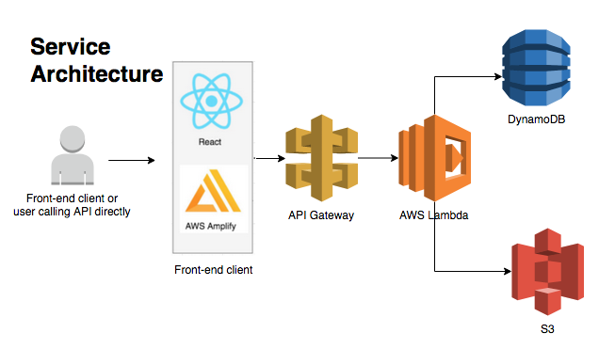
Service Architecture: Community News Bulletin
Notes:
This service will be backed with the most popular AWS technologies that we just went over. We will be using
Amazon S3 to hold the content of our news articles. Since these articles can be large, just like images, and so Amazon S3 is the perfect candidate for storing this information
Amazon DynamoDB to hold our metadata that we want to easily query, like the title of the article, the location of the content in S3 and other such information or metadata pertaining to the news article.
AWS Lambda will be our event-driven, serverless compute, that will respond to requests made by the client and do the needful, and interact with DynamoDB and S3, as required.
Amazon API Gateway will be our API Gateway.
AWS Amplify will help us quickly generate our back-end resources as also a framework for our front end application.
I’m going to explain the journey of a request made to the back-end, so pay close attention.
In order to make a request, a user first logs onto the webpage that is on your browser. There they perform certain actions like loading the webpage to read the articles or adding a new article of their own. The front-end application converts these actions performed by the user into the respective APIs and calls the service on behalf of the user. So a network call is made to your service.
This call reaches the API gateway which processes the request and forward it to the relative AWS Lambda function. For our workshop today, we will be hosting each API on a separate Lambda function. Each lambda now knows its functionality.
Now, if it is a write API, like adding a news article, the functionality of that Lambda would be add this information into DynamoDB and S3.
If it is a read API, like loading the webpage, then the lambda retrieves information from backend databases aka DynamoDB and S3 and return it back to the front-end framework.
The front-end framework will “prettify” your response and provide that to the end user.

Slide 16
Setup
https://github.com/uttarashekar/ghc_2020_aws_workshop/blob/master/README.md
Notes:
Let’s finally jump into setting up for our workshop. For this, let’s navigate to the README that I’ve provided here. Uttara has added this link on the chat box.
As we have gone over how AWS services are all super super secure, the toolchain would need access to your AWS resources. We will be doing this by using the `amplify configure` command.
AWS Identity and Access Management (IAM) is a web service for securely controlling access to AWS services. With IAM, you can centrally manage users, security credentials such as access keys, and permissions that control which AWS resources users and applications can access.
AWS Cloudformation is an AWS service that builds and provisions your AWS infrastructure, repeatedly, and in our case, predictably. It does this by using a template file to create and delete a collection of resources. Amplify takes advantage of this AWS resource to build your back-end resources. So in simpler words, AWS Amplify calls Cloudformation provided API which helps create resources for us.
With this, over to you, Uttara

Slide 17
Build Service Components
Notes:
Uttara has added a link which will take you to a github readme that has information for setup. Now, over to Uttara who will guide you through this workshop.
A quick note: If you have any issues during the workshop with the setup or any other technical questions, please feel free to ask in chat, and I’ll get back to you as soon as I can.

Slide 18
Activity 1 – ReadStories API

Slide 19
Activity 2 – CreateStory API

Slide 20
What can you build?

Slide 21
Do It Yourself!
ReadStory API
LikeOrComment API
Add a Local Businesses Table
Move Create Story to a page with authentication

Slide 22

Thank You!
https://www.linkedin.com/in/uttara-shekar-0aa20645/
https://www.linkedin.com/in/melonia-mendonca-b9b17b33/

